Slide 1
Trend Reversal
Kabir Buch, Michael Hansen, Eliot Huang, Georgia Martin

Slide 2
Trend Reversal Strategy Definition
Overview
- Intuition
- Divergence
Technicals
- MACD
- Trading Specifications
Code
- Algorithm
- Backtesting
Results

Slide 3
What is Trend Reversal?
Identifying price shifts before they occur

Slide 4
Strategy Intuition
Stocks tend to have trending periods of increasing/decreasing price.
This is the basis of momentum trading: buying high, selling higher.
Identifying when the trend/momentum is shifting can allow us to predict price shifts. Changes in price tend to be preceded by changes in momentum.
Our goal is to identify when a stock price trend is changing before it does

Slide 5
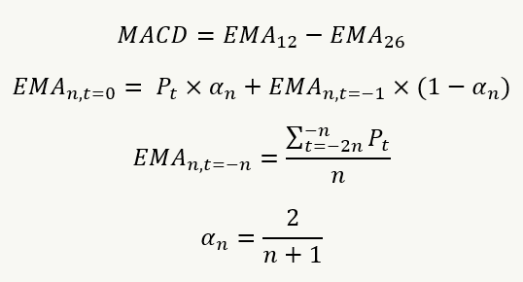
MACD
Moving Average Convergence Divergence
A formula that compares Exponential Moving Averages (EMAs) of different periods against each other.
Note: Exponential Moving Average is a type of moving average that places greater weight on more recent data points.
Notes:
In supplementary we might go thru derivation
DGQT does derivation (I believe) – I think it’s nice to understand, but not too useful for right now

Slide 6
Understanding the Divergence Signal
We are going to use MACD as functionally a “derivative” of price
When prices hit all time highs or lows, we want to know how MACD is changing
If prices are reaching an extremum but MACD is not, then we’ve identified a divergence
This decoupling of the variable and its derivative suggests a trend reversal, which we capitalize on.

Slide 7
Trading Specifications
Hope to trade:
Moderate volatility markets so price swings are sufficiently significant to generate clear indicators, but not so erratic that noise––such as false divergences––obscure the signal.
Range-bound markets, i.e., those oscillating between a high and a low. In these markets, divergence between price and MACD is more likely to indicate a coming reversal rather than the continuation of a powerful trend.
Large-Cap stocks, because higher liquidity means price data tends to be smoother and less prone to erratic moves caused by low trading volume. This makes our EMAs (and hence the MACD) more reliable.

Slide 8
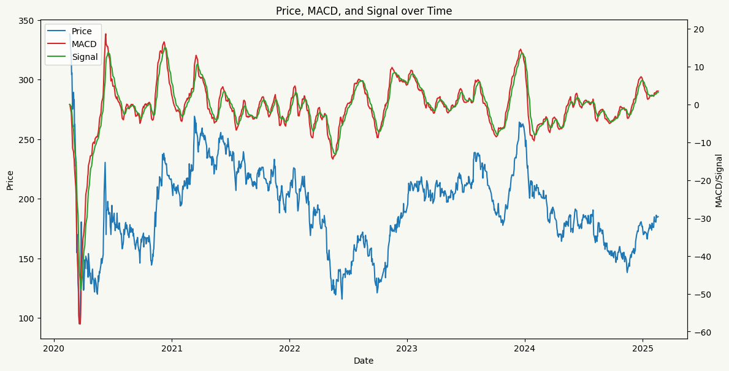
Boeing

Slide 9
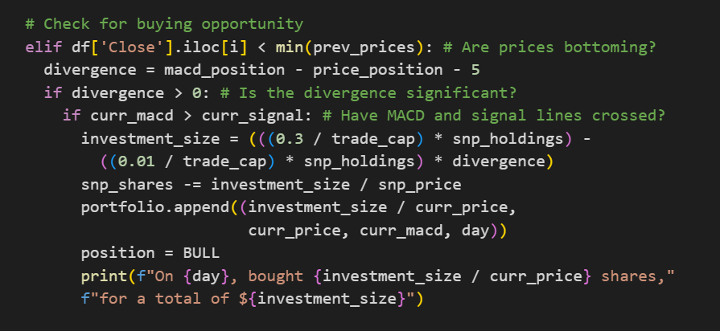
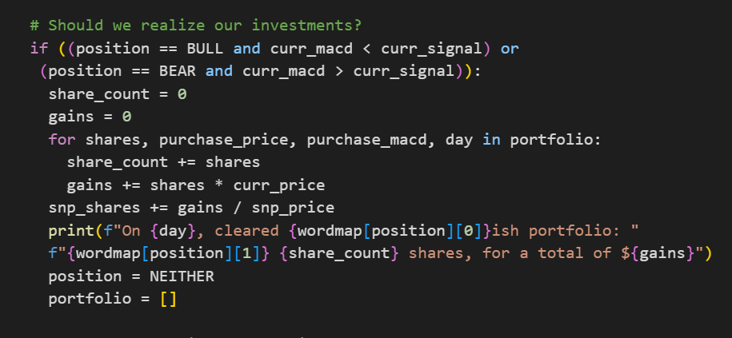
Code
Logic for bullish divergence: Scans the rolling window and checks if MACD’s relative position is significantly lower than price’s
Logic for realizing investments: sell/cover when MACD and signal line have crossed, indicating that MACD momentum is ending
Link to view code with Colab: https://colab.research.google.com/drive/1vuRTip0BRVUVpcb6-YU6JDhzwX9m3ZGt?usp=sharing

Slide 10
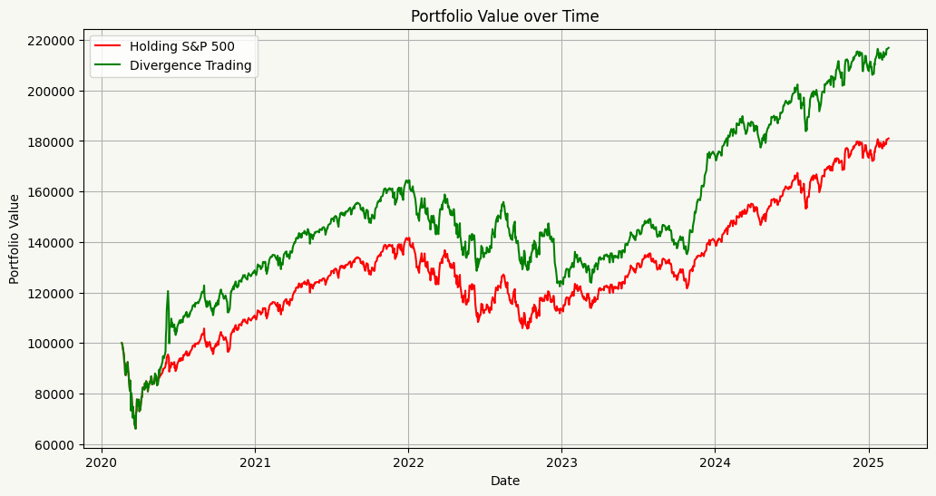
Results

Slide 11
Questions?
Thank you

